Slide 1
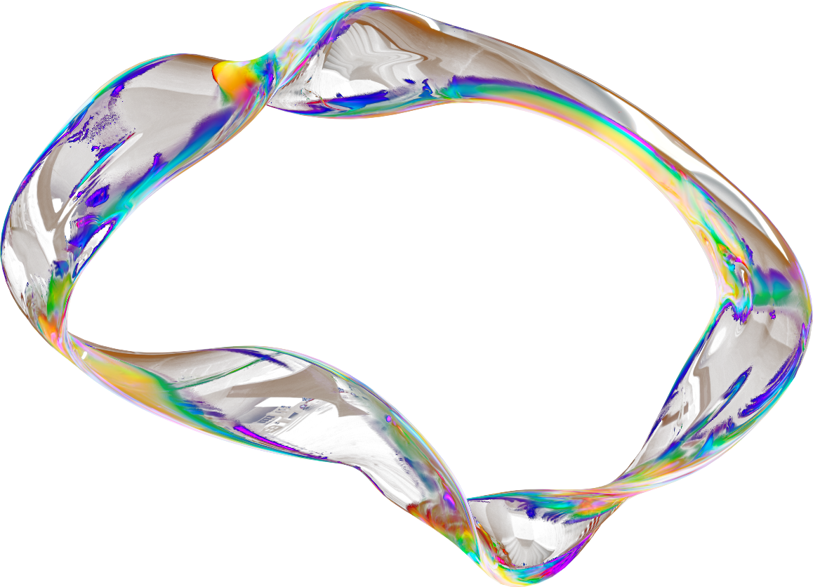





GROUND
ZERO
Project Title → AI-Powered Groundwater Intelligence for Sustainable Farming and Policy Action
TrailBlazers
Presented by Team
“Turning Raw data into water security”
PRIYANSHU
KUMAR
MUKUL
SHARMA
AASHI
GUPTA
AMRIT
JAISWAL
YUVRAJ
BUNDELA
Team Leader, App Developer
ChatBot/AI, Backend Manager
Data Analyst, Python Expert
UI/UX Designer
Database Manager, UI/UX

Slide 2
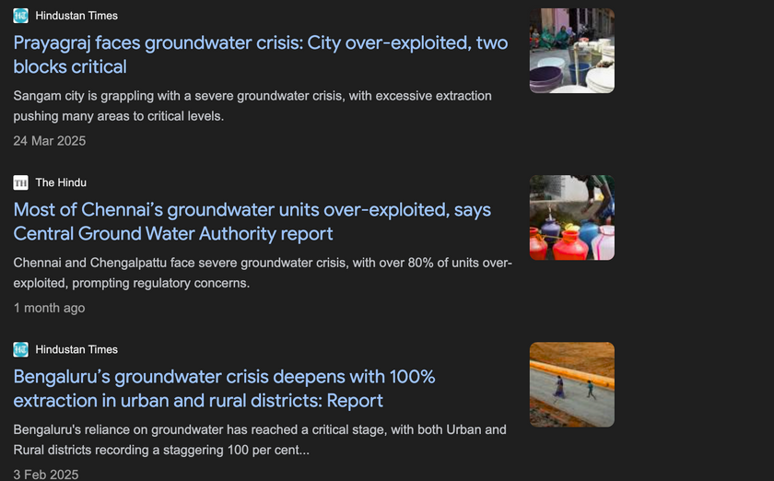
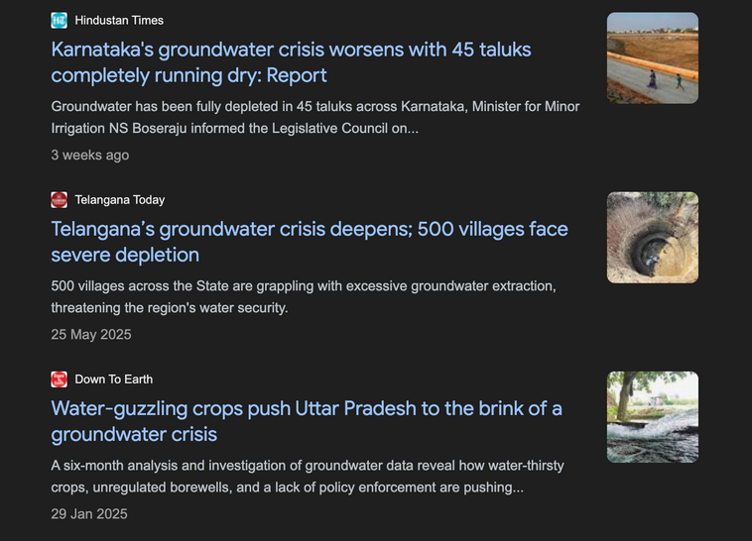
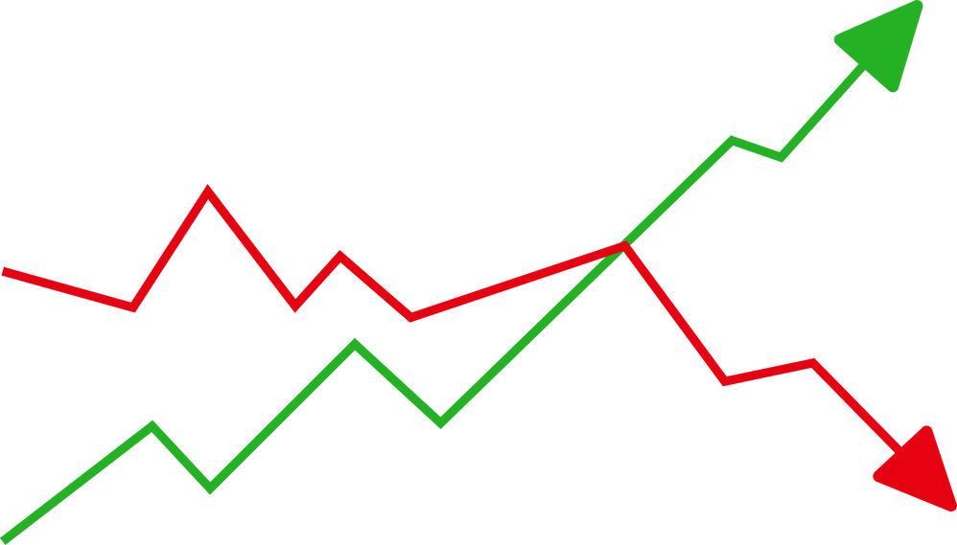
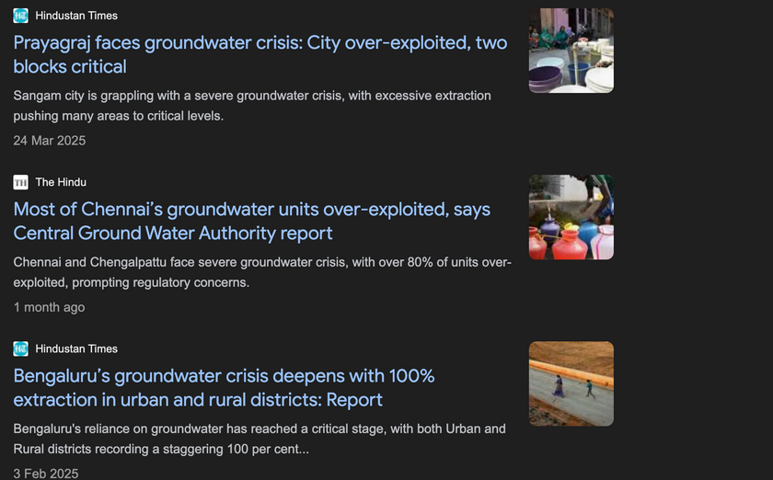
PROBLEM
STATEMENT
India, the world’s largest consumer of groundwater, is facing an unprecedented crisis. Groundwater levels are declining in 77–80% of monitored wells across regions such as the Chota Nagpur Plateau and North India, with annual drops of up to 0.205 meters. In North India alone, between 2000 and 2020, nearly 170 km³ of groundwater was lost—equivalent to the storage of the world’s largest dam. This over-extraction, coupled with climate variability, has pushed India toward severe water scarcity, with per capita water availability projected to fall to 1,140 m³ by 2050, well below the scarcity threshold of 1,700 m³. Also, 65% of irrigation and 85% of drinking water needs depend on groundwater.
Lack of Real-time monitoring and actionable data: There is a critical gap in real-time, accessible groundwater data for farmers and policymakers, hindering timely interventions and sustainable management 2012.
Existing tools are fragmented, slow, and product-focused : They don’t provide real-time, localized, AI-driven groundwater intelligence or integrate with agri-business services. Farmers and policy makers still lack one unified, actionable platform for sustainable water decisions.
Population
GroundWater
Level

Slide 3
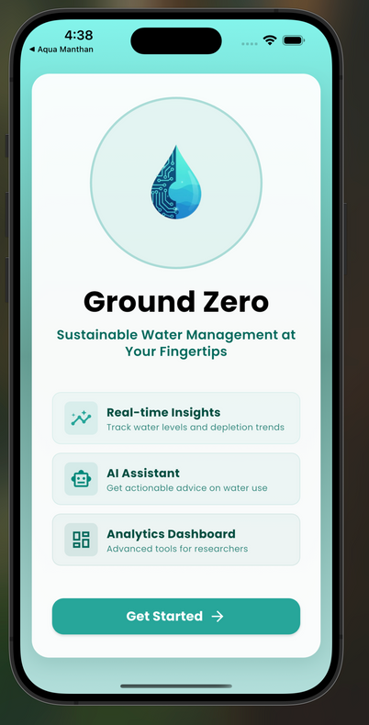
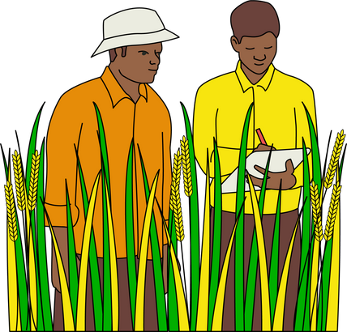




PROPOSED
SOLUTION
We reviewed around 25 research papers spanning groundwater depletion, AI-based irrigation planning, and agri-advisory systems. Several papers demonstrate that AI and remote sensing can dramatically improve forecasts, risk assessment and water-use optimisation. Together these findings clearly point to a gap: the absence of a real-time, integrated platform serving farmers, policy makers and researchers. These insights directly shaped Ground Zero design, turning evidence into a practical solution.
Ground Zero
Is an AI-powered groundwater intelligence platform that converts scattered data into clean, real-time, actionable insights.
It equips farmers, policy makers and researchers with forecasts, risk alerts and decision-support tools for proactive water planning and scientific analysis.
The platform replaces fragmented information with one unified, science-based advisory — improving resource planning, reducing risk and driving water security at scale.
For Farmers (Krishi Mitra)
AI chatbot provides irrigation and water-use advice in simple language, while also displaying current government schemes and policies so farmers can make informed, policy-aligned decisions.
For Policy Makers (Niti Drishti)
Dashboards highlight depletion hotspots, recharge patterns, and long-term risks, helping frame evidence-based water management strategies and targeted interventions.
For Researchers (Anusandhan)
Unified groundwater- rainfall datasets with advanced analytics enable deeper studies, predictive modeling, a dedicated research dashboard consolidates publications, work progress, and analytical tools in one place, alongside integrated groundwater–rainfall datasets for advanced studies.

Slide 4

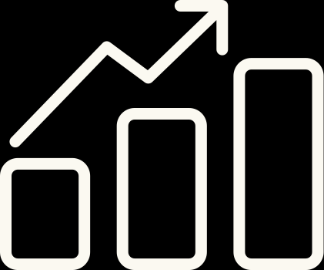

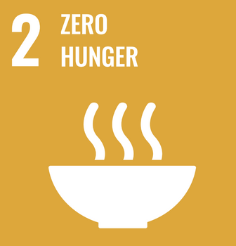
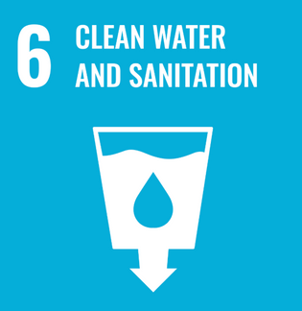
OBJECTIVE &
GOALS
Objective of The App
Develop an AI-powered groundwater intelligence platform that unifies farmers, policymakers, and researchers.
Translate complex groundwater and rainfall data into simple, localized insights for sustainable farming.
Provide real-time, evidence-based dashboards to support policy framing and water governance.
Build an integrated research hub to accelerate groundwater studies and innovation.
Goals of The App
Reduce over-extraction of groundwater by promoting smart irrigation practices.
Empower policymakers with predictive analytics for hotspot detection and recharge planning.
Enable farmers to save 15–20% water per crop cycle while improving yields.
Contribute to SDG-6 (Clean Water) and SDG-2 (Zero Hunger) by driving sustainable water use.
Scale nationally as the go-to digital ecosystem for groundwater sustainability.

Slide 5
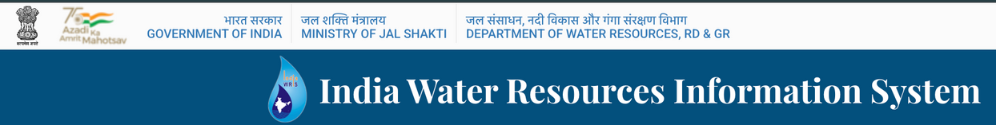



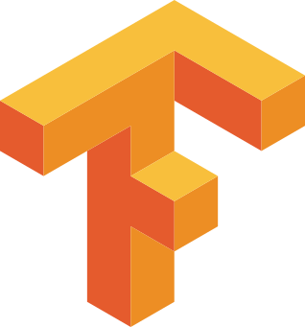

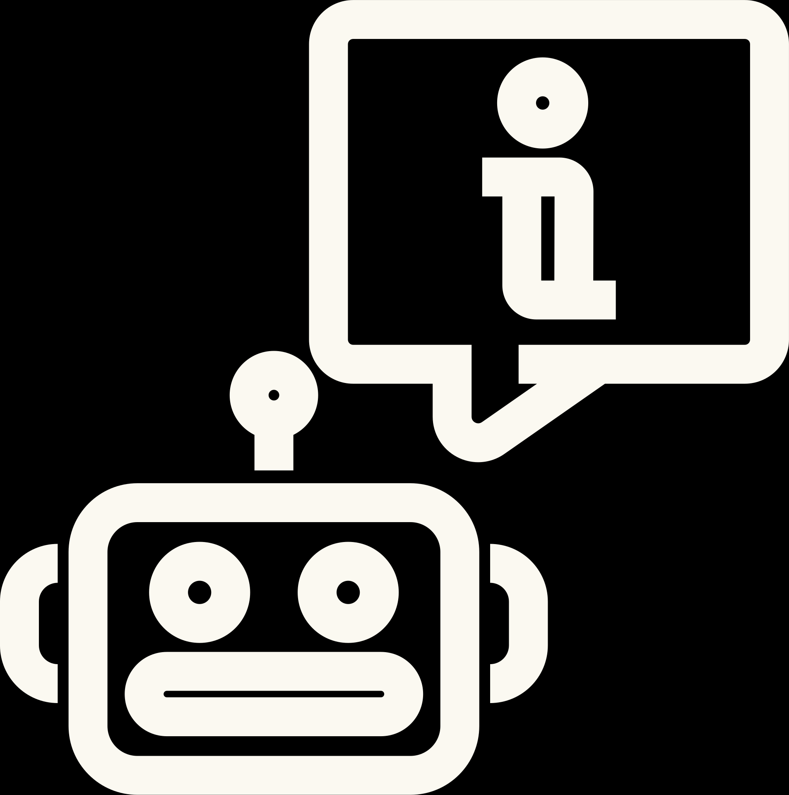

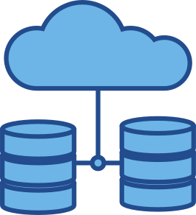
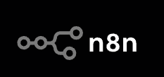
Tech Stack
Backend and Processing
Python(FastAPI)
NodeJS(Express)
Kafka(Streaming)
DataBase And Storage
PostgreSQL + PostGIS
TimescaleDB → For efficient storage of WRIS time-series water level data.
External Data Sources
-> WRIS (Groundwater Data),
Users
Government Agencies( Policy makers)
Researchers
Farmers
Analytics & Machine Learning (Libraries & Tools)
• Pandas, NumPy, SciPy → Data cleaning &
preprocessing.
• Scikit-learn,Prophet library →ML models for
forecasting groundwater trends.
Leaflet.js / Plotly.js → Interactive graphs of water level trends.

Slide 6
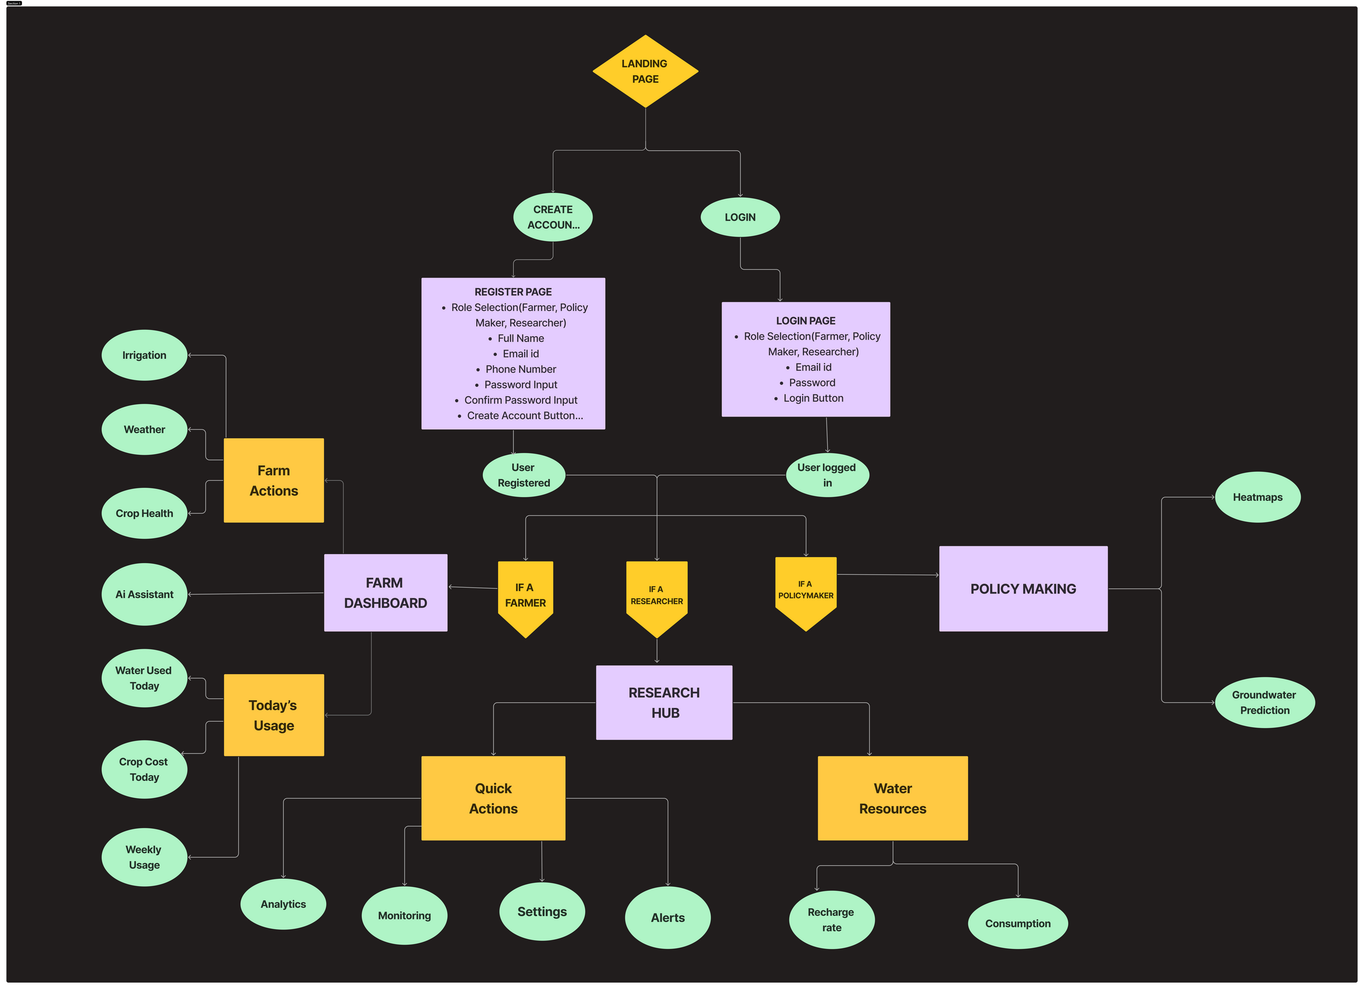
System WorkFlow &
USP of Ground Zero
A single platform that focuses on Real-time groundwater, rainfall, and quality data, applies AI forecasting, works offline for rural users, speaks farmers’ languages, and simultaneously serves farmers, policymakers, and researchers—bridging raw data to actionable decisions and existing national water programs.

Slide 7
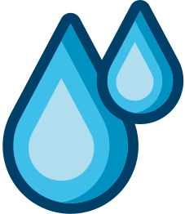
KEY FEATURES AND INNOVATION
Real-Time Data Fusion: Combines rainfall, groundwater, and quality metrics (like pH, salinity) into a single intelligence layer.
Predictive Forecasting: AI/ML models project aquifer depletion and recharge potential weeks to months in advance.
Offline-First Access: Works in low-connectivity rural areas with lightweight sync once internet is available.
Trust & Transparency: Open-data architecture with government-backed datasets ensures reliability and credibility.
Decision Support Alerts: Push notifications for drought risk, irrigation timing, and recharge opportunities.
Climate Adaptation Ready: Integrates climate variability and rainfall anomalies to future-proof farming and policy.
One Ecosystem, Three Stakeholders: First platform to simultaneously serve farmers, policymakers, and researchers.
AI Translation Layer: Converts complex hydrological data → simple farmer-friendly guidance (Available in Multi Language Mode.)
Policy-First Focus: Dashboards designed for governance and intervention planning, not just raw data display.
AI-to-Action Bridge: First solution that turns raw groundwater data into real-time, location-specific advice for farmers, in their own language.
Research Acceleration Engine: A built-in hub where datasets, publications, and analytics tools are consolidated → saves researchers months of effort.
Scalable National Backbone: Designed to plug into Jal Jeevan Mission, Atal Bhujal Yojana, and state water boards for immediate adoption.

Slide 8
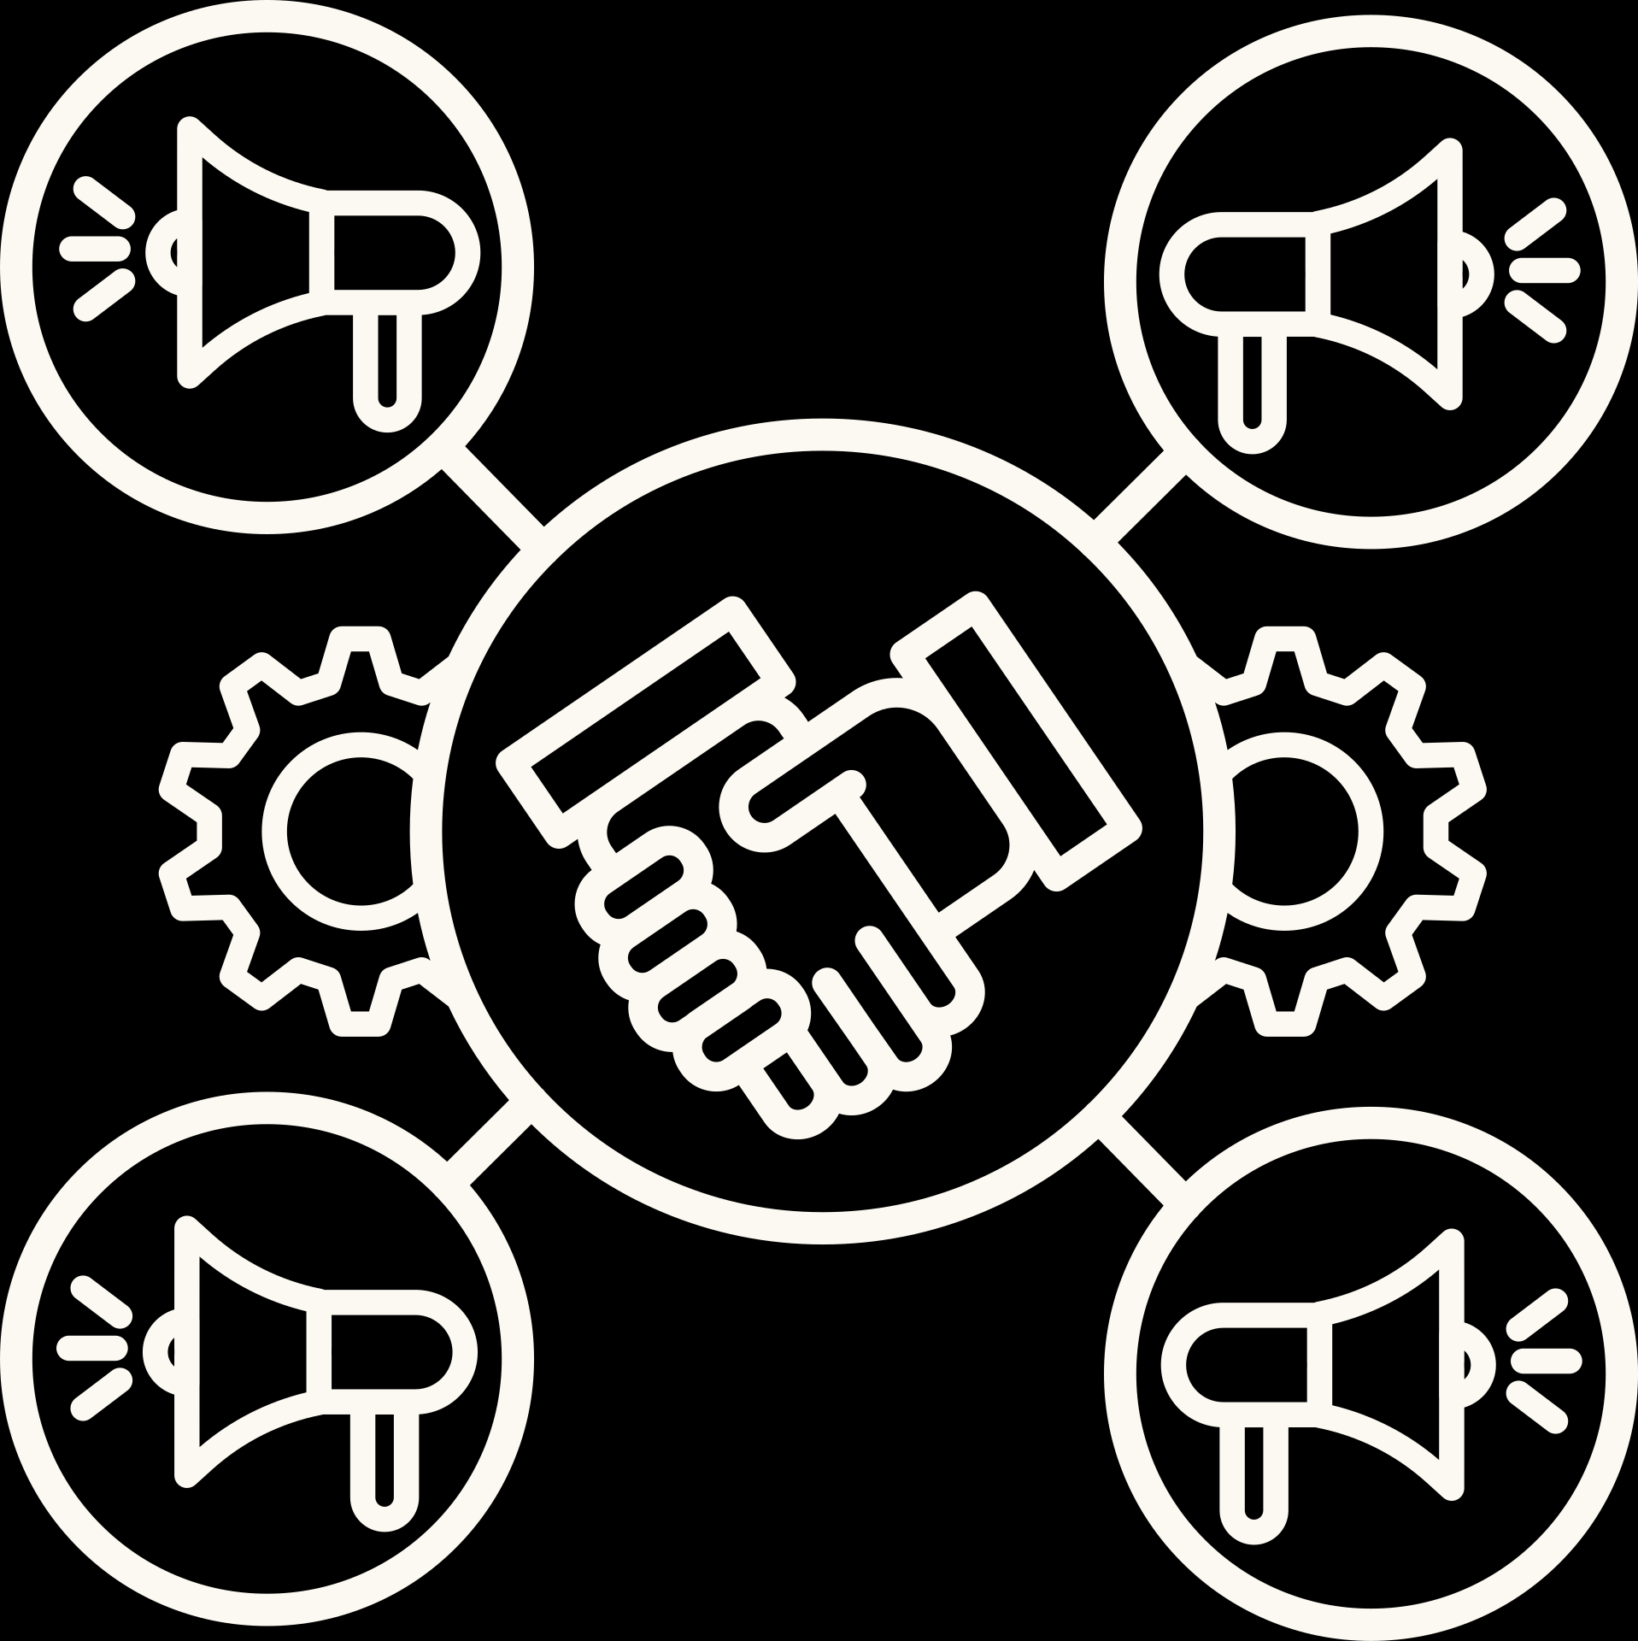
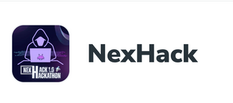

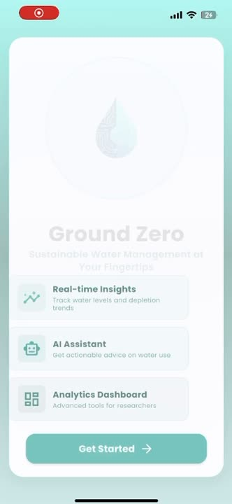

Implementation Plan
IDEA TO MARKET
1. Farmer Chatbot (n8n + Flutter)
Live demo: farmer asks “Should I irrigate wheat today in Varanasi?”
Chatbot responds with rainfall + groundwater trend + irrigation tip.
2. Real-time Data Simulation And ML Model Formation and Refining
Dashboard auto-updates with groundwater + rainfall (mock-streamed from WRIS/IMD historical data), Model get improved in Its Accuracy Part.
3. Policy Dashboard (Predictive Mock)
Heatmap showing district water stress.
Prototype curve projecting groundwater depletion/recharge next 6 months.
Next 3–6 Months
Integrate real datasets (WRIS, IMD, CGWB water quality).
District-level pilot with farmers (via Krishi Vigyan Kendras & FPOs).
Refine ML models for groundwater depletion & recharge predictions.
Partnerships with state water boards for early adoption.
Scalability (6–18 Months)
Multi-district pilots across high-stress states (UP, Punjab, Rajasthan).
National rollout aligned with Atal Bhujal Yojana & Jal Jeevan Mission.
Future upgrades: IoT sensors, satellite data, climate anomaly alerts, multilingual farmer support.
Phase 0
Phase 1
Phase 2
Business Model

Slide 9
Challanges &
Risk Management
Mitigation: Start with WRIS & IMD validated data, use predictive AI models to fill gaps, integrate IoT sensors in later phases.
Data Availability & Quality
Risk: Gaps in groundwater datasets, inconsistent field measurements
Mitigation: Regional language chatbot, voice-based interaction, on-ground partnerships with Krishi Vigyan Kendras & NGOs.
Farmer Adoption
Risk: Gaps in groundwater datasets, inconsistent field measurements
Mitigation: Cloud-based infrastructure (AWS/Firebase), modular architecture for easy scaling.
Technical Scalability
Risk: Handling large-scale datasets and predictive analytics for multiple states.

Slide 10
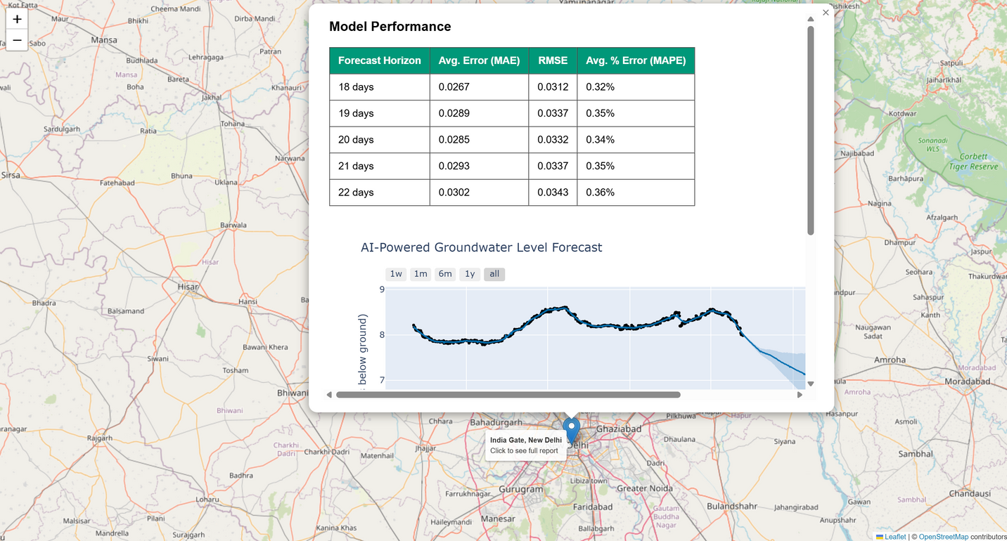
IMPACT & SOLUTION
Viability
Practical & Valuable: Directly addresses water security, a critical national issue for the Ministry of Jal Shakti.
Sustainable & Scalable: Uses government’s own data, ensuring easy adoption, integration, and long-term nationwide expansion.
Financially Viable: Low-cost deployment since data sources are public and infrastructure is lightweight; scalable model minimizes recurring costs while maximizing national impact.
Feasibility
Data Availability: Core rainfall and water-level data already accessible via India-WRIS.
Proven Tech: Uses reliable, industry-standard tools (Flutter, React, Python, Prophet).
Achievable Scope: Functional prototype for Delhi station built, scaling requires execution, not invention
Average error ~3% → If the groundwater depth is 10 m, the model may be off by only ~0.3 m.
RMSE ~0.3 m → Predictions are very close to real values.
Conclusion: The model is highly reliable for groundwater and captures daily patterns very well.

